Slide 1
Programming 4
06.2 Tile Map
Semester 2, 2019

Slide 2
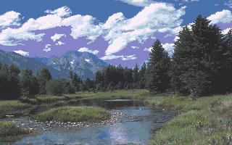
Single image
Notes:
Huge
In a game, or scientific simulation or other large graphical application, the world is usually much bigger than the computer screen, so this image might have to be very big
If you need a very large image, or multiple levels, it rapidly becomes very huge
For consoles and older PCs it was impossible, the image could require more RAM than the machine had
Rarely see this kind of background
Instead, we use a method called “Tile Mapping”.

Slide 3
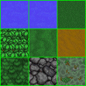
Tiles
Notes:
You use a small(ish) set of tile images, and lay them down like a tile floor to create the background

Slide 4
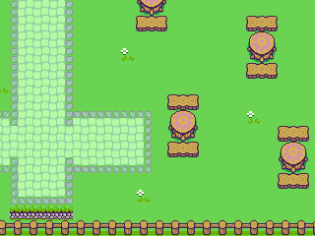
Tile based

Slide 5
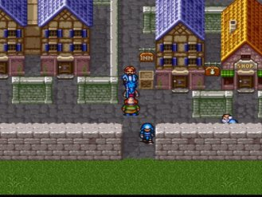
Tile based

Slide 6
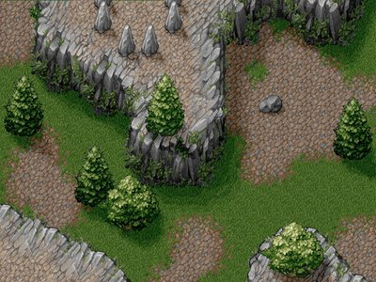
Tile based

Slide 7
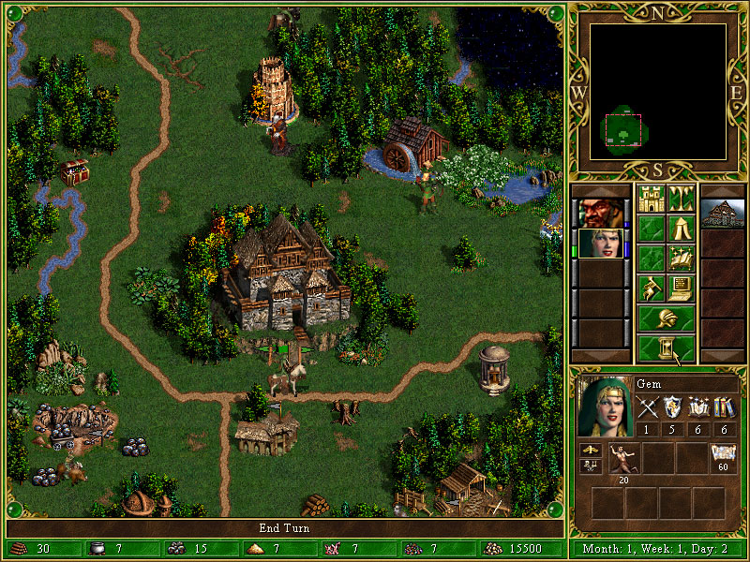
Tile based
Notes:
Heroes of Might and Magic

Slide 8
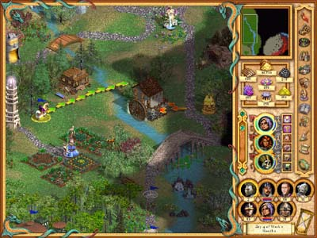
Tile based
Notes:
Heroes of Might and Magic

Slide 9
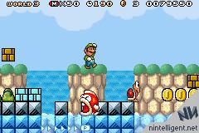
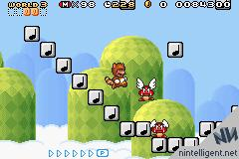
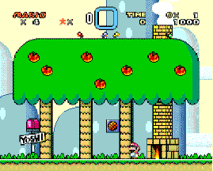
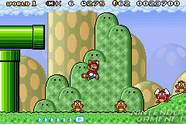
Tile based – side view
Notes:
Backgrounds are drawn from different viewer perspectives. This is side-on. It uses rectangular tiles and
These images use multiple layers of background, combined with tile pseudo-transparency, to give an appearance of depth is very easy to do
If they scroll, they will also use “parallax scrolling” – where the different layers scroll at different speeds” to enhance the illusion

Slide 10
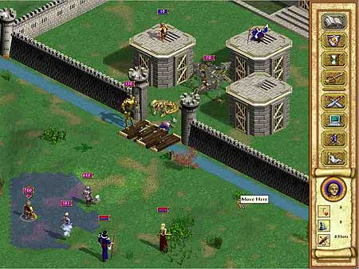
Tile based – isometric
Notes:
Isometric draws the world at 45 degrees. The tiles are diamond shaped (or sometimes hexagonal)
This fools the eye into seeing a diminishing perspective, so it looks sort of 3D. But it’s not. It’s just art magic
Isometric backgrounds are implemented in basically the same way as rectangular tile backgrounds like Bird’s eye and Side-on, but the maths required to line the tiles up is much, much more complicated. We will not do isometric in this class
Heroes of Might and Magic

Slide 11
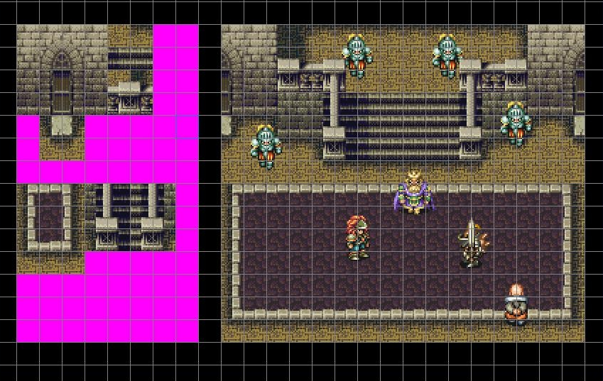
Tile sets

Slide 12
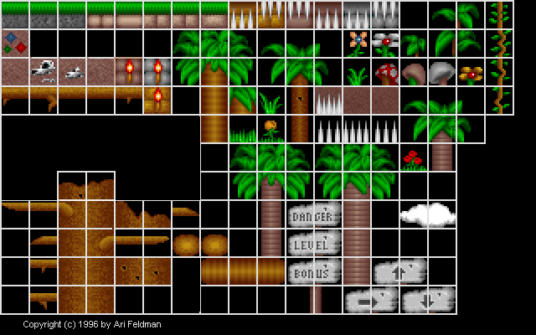
Tile sets

Slide 13
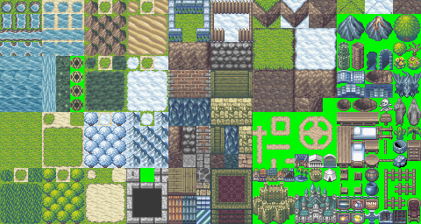
Tile sets
Notes:
http://reinerstileset.4players.de/

Slide 14

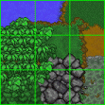
Terrain transitions
Notes:
To look really good, you can make tiles that give smooth transitions between different primary terrain types
Note that N terrain types will require O(N2) transition tiles

Slide 15

Terrain transitions
Notes:
Really good transitions may require many tiles to get from terrain to terrain

Slide 16
Tile based – Roguelike
Notes:
We will be implementing a style of game called a Roguelike
This is basically “dungeon crawler with procedurally generated maps” (we will talk about how to do that in a couple of weeks)
We will be using a tilemap background
The minimum passing requirements will be fairly basic, but you can get some fancy stuff going if you want to
Here are some assorted images from the web...
Rogue-likes use bird’s-eye view
This one has a world that is bigger than the computer screen and will use a technique called “scrolling”, where you have a really big background, and you only display the portion of it which is centred around the player character’s current position

Slide 17
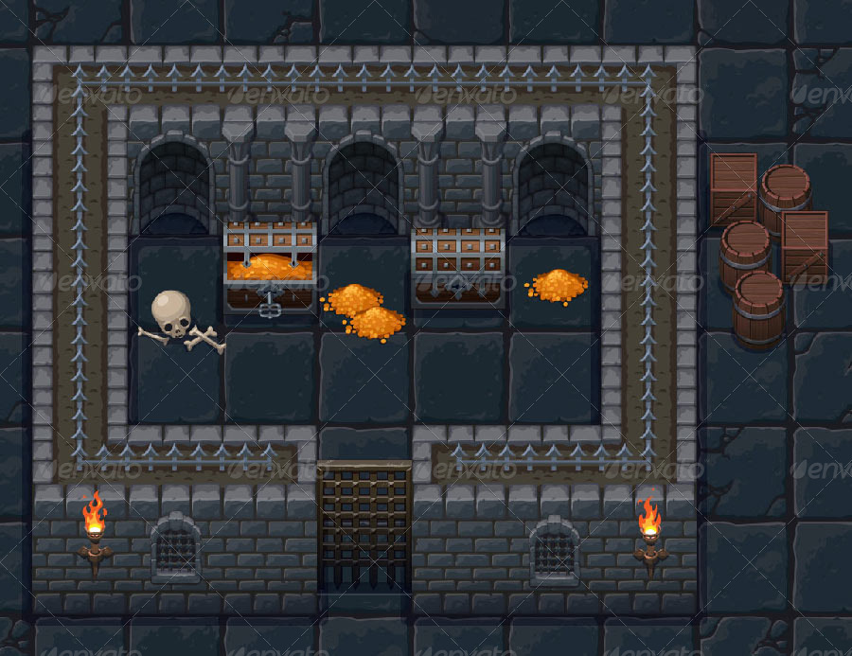
Tile based – Roguelike

Slide 18
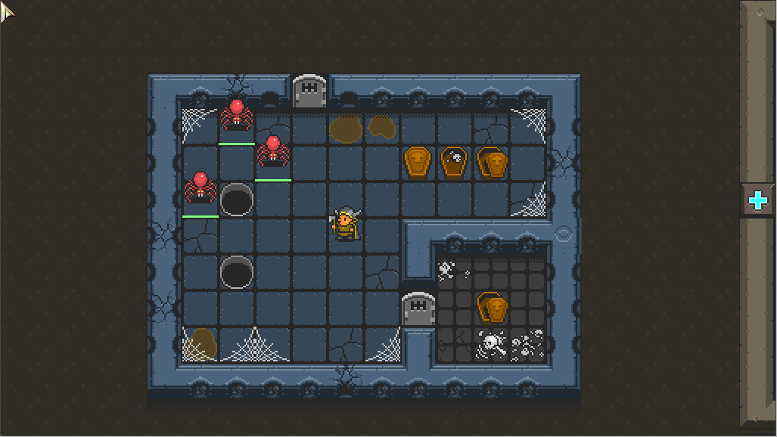
Tile based – Roguelike

Slide 19
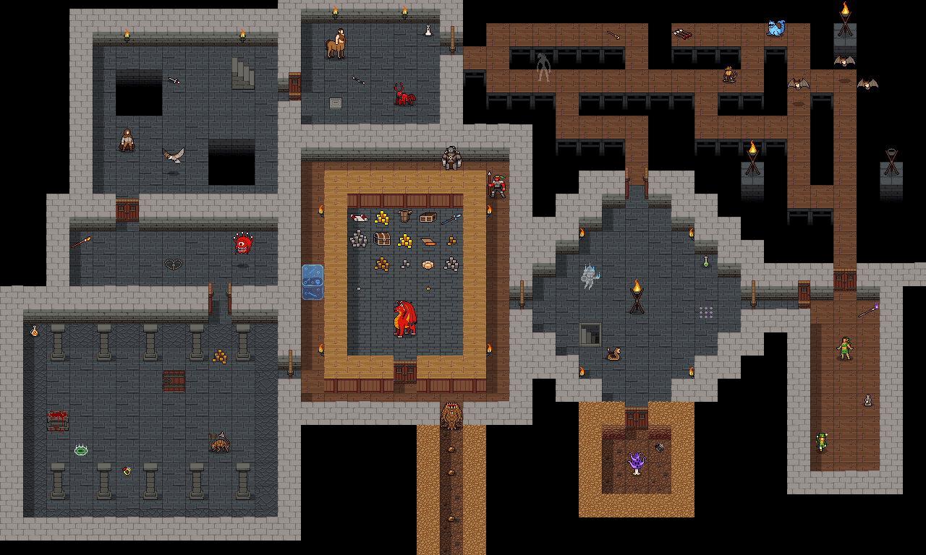
Tile based – Roguelike

Slide 20
Tile based – Roguelike

Slide 21



Implementing a tile background
Number your tiles from 0 to n
Make a layout of numbers
Translate the layout into a tile background
0 | 0 | 1 | 0
0 | 0 | 1 | 1
0 | 0 | 0 | 0
2 | 2 | 2 | 2

Slide 22
Required classes
Tile
Bitmap^ tileBitmap
State information – bool isWalkable
TileList
An array of Tile^
Methods to load and access array of Tile^
TileMap
A 2D array (the map) of indices into TileList’s array
Knows how to draw itself
Notes:
Preparing for the future

Slide 23
Implementing a tile background
TileList has an array of Tile^
TileMap has a 2D array of ints
TileMap draws itself
0 | 0 | 1 | 0
0 | 0 | 1 | 1
0 | 0 | 0 | 0
2 | 2 | 2 | 2

Slide 24
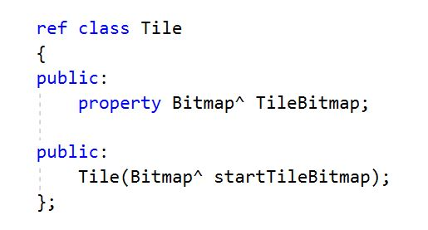
Tile class

Slide 25
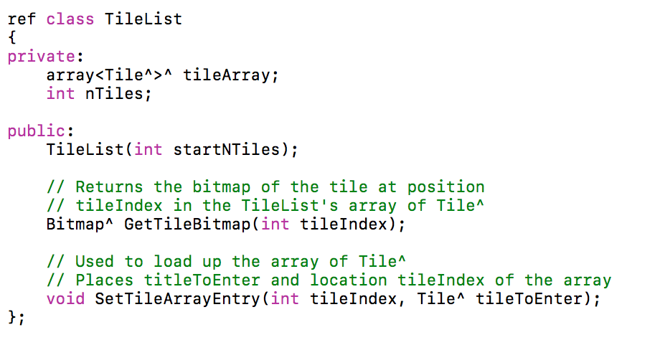
TileList class

Slide 26
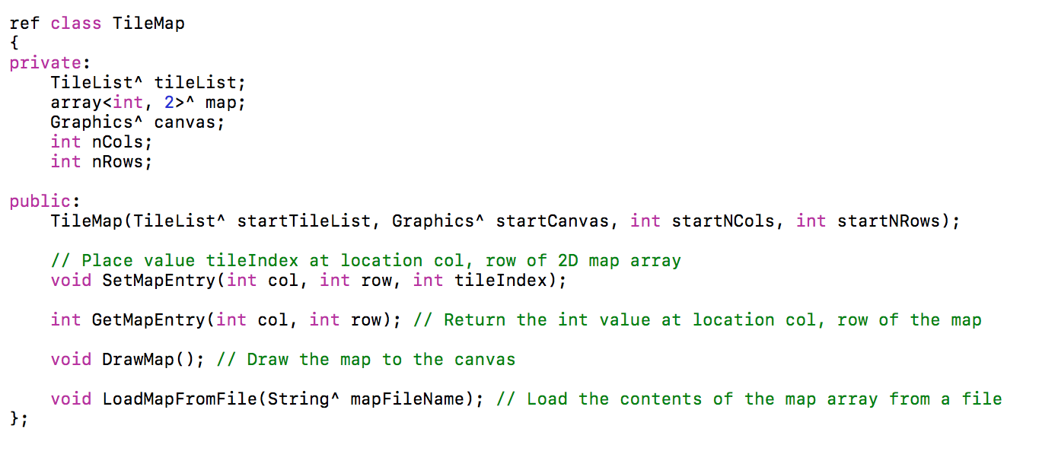
TileMap class
Notes:
Ignore LoadMapFromFile() – we will look at this soon

Slide 27
How TileMap draws itself
For each cell in the map array (the 2D array of ints)
Use the value in the cell to retrieve the associated bitmap
Use TileList::GetTileBitmap(in tileIndex) to get the Bitmap^
Compute the location fro this tile on the canvas
Draw the bitmap to the canvas at that location
Notes:
Preparing for the future

Slide 28
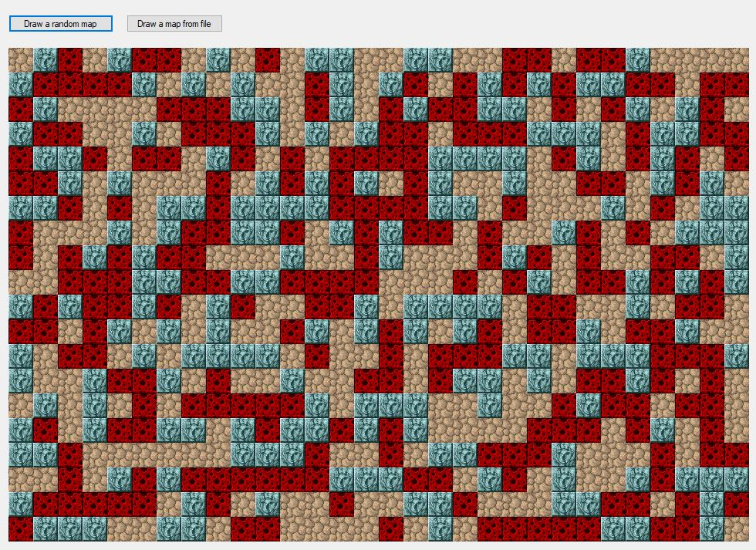
Task 1 – random map

Slide 29
You need to…
Create all the Tiles
Create a TileList and load it up with your
prepared Tiles
Create a TileMap, passing in your prepared TileList
Write a method to randomly fill the TileMap’s map
with integers 0 to n-1, where n is the number of Tiles
Notes:
Preparing for the future

Slide 30
Task 2 – map from file

Slide 31
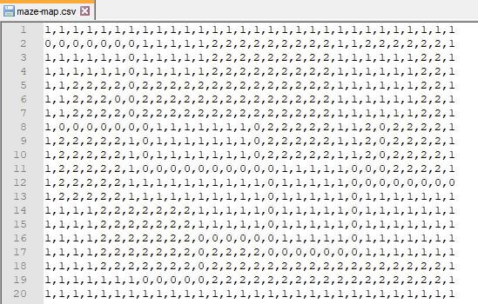
Task 2 – map from file
Notes:
Here is a CSV file you can use in development. 20 rows by 30 columns
Given the tile assignments in my code, (0 = tileOne, 1 = tileTwo and 2 = tileThree)

Slide 32
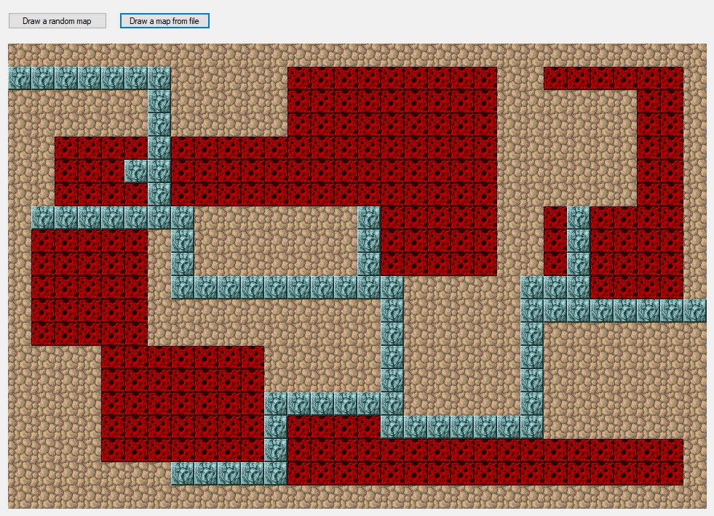
Task 2 – map from file

Slide 33
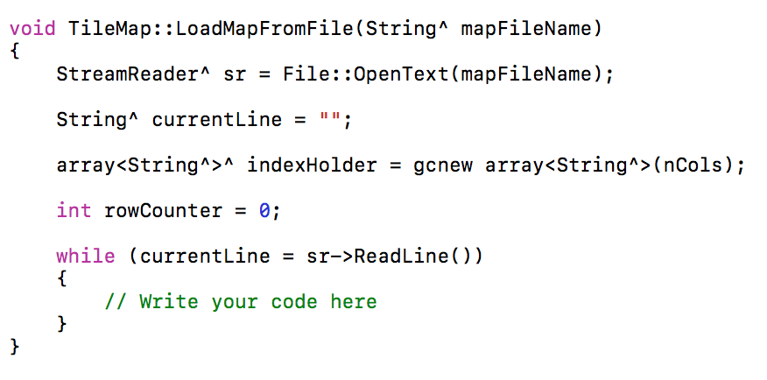
Task 2 – map from file

Slide 34
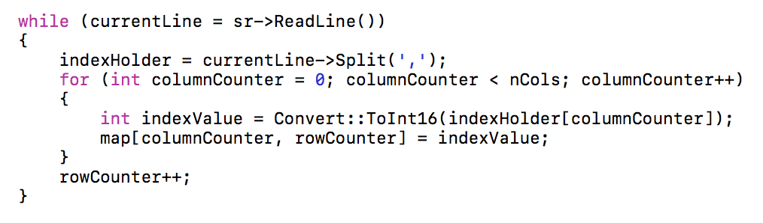
Task 2 – map from file

Slide 35
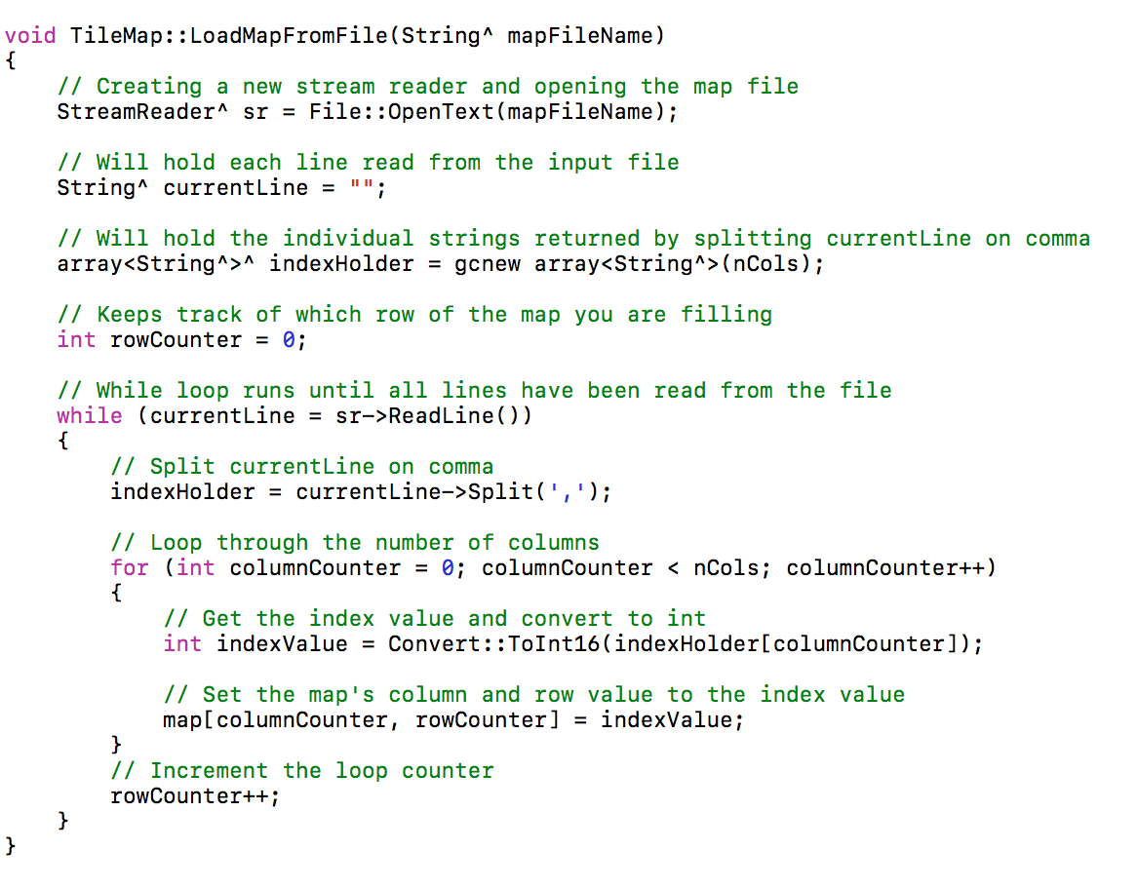
Task 2 – map from file

